Slide 1
EMBARK matchmaker
https://my.embarkvet.com/members/breeder-tools
Introduction to accessing and using the EMBARK matchmaker tool for breeders

Slide 2
First things first!
Make your Stabyhoun’s basic information available to the public. This way, the breeder tool is most effective!
Log into Embark:
https://my.embarkvet.com/members
1. Select “BREEDER TOOLS” by clicking on that area
2. Select “DOG SETTINGS” by clicking it.
3. Set privacy settings to “PUBLIC” by clicking on each box under “Matchmaker”, “Breed”, “Health”, “Traits”
4. SAVE your selections!

Slide 3
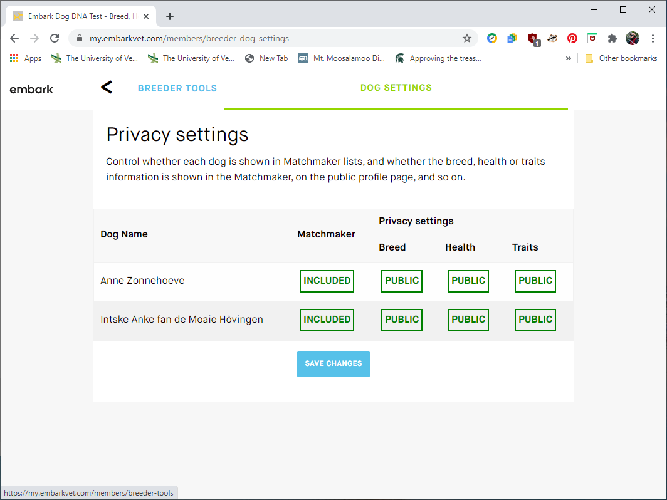
Next Step…
SAVE YOUR CHANGE TO “PUBLIC”
From the “DOG SETTINGS” screen, after you made your Stabyhoun “public”…
Please do not add non-breeding dogs to the Matchmaker, but make their other info public.
Click on “BREEDER TOOLS” to get back to the action!

Slide 4
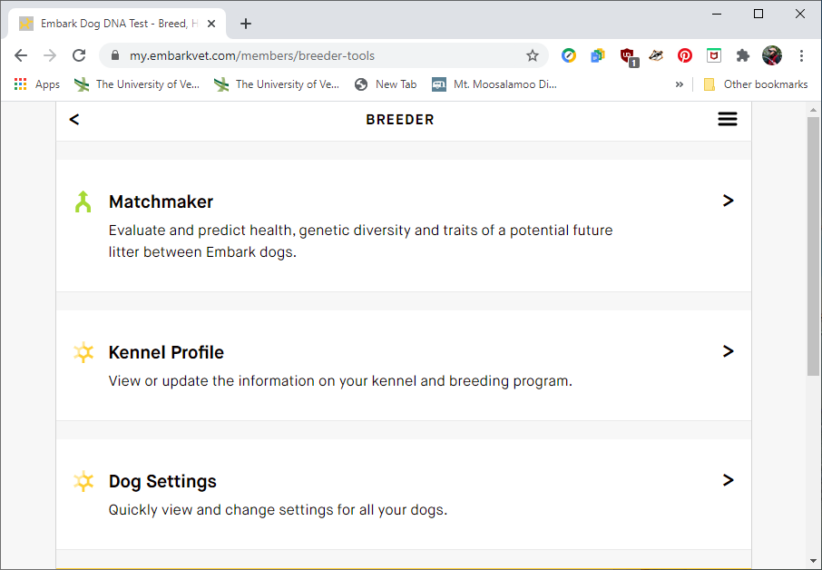
Now for the fun…
In the “Breeder” screen…
Click on “MATCHMAKER”

Slide 5
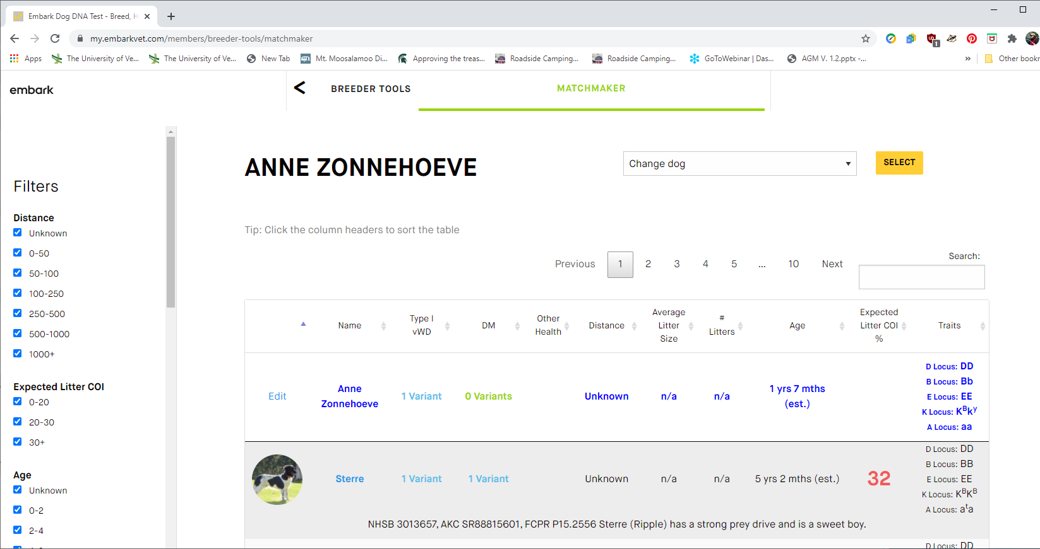
Take a look around…
Your dog is at the top of the chart. You can change dogs to the right. Potential mates are below.
There are filters on the left side – you can look for breeding age dogs only, for instance. You can look for dogs within a certain distance, too. Click on the check box to select or unselect each filter.
Each column in the chart can be sorted, too – try clicking on “Expected Litter COI” to quickly find the lowest COI possible.

Slide 6
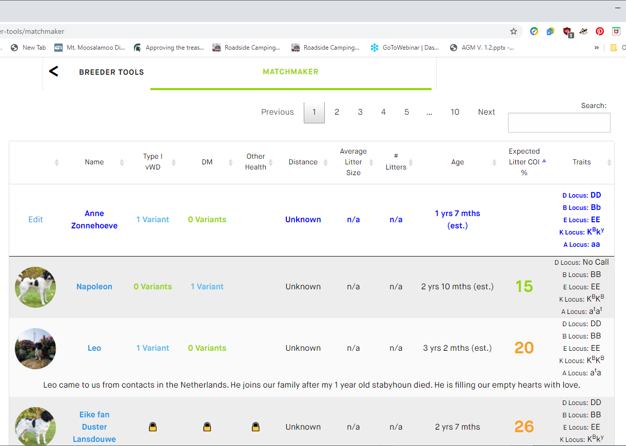
Low expected coefficient of inbreeding (COI) for litter
Click on the column heading “Expected Litter COI %”, and it will sort least to most, or vice-versa.
For Anne, Napoleon and Leo have very low COI estimates.
Eike fan Duster Lansdouwe has a pretty low COI with Anne , compared to the average 30-31% for Stabyhouns, too. Their expected COI of a litter is 26. Right now – Eike’s vWD (von Willibrands disease), DM (Canine degenerative myelopathy), and other health are not public.

Slide 7
Find out more…
Even if Eike is set to “private”, I can find out some things about him, if he is a potential candidate for Anne.
CLICK on the dog’s photo to bring up his profile which includes age, registration, etc.
With name and registration, if the dog is in the ZooEasy database, we can see what the pair’s health pedigree would look like.
Here we see that I contacted Eike’s owner in March 2019, by clicking on the button “CONTACT OWNER”

Slide 8
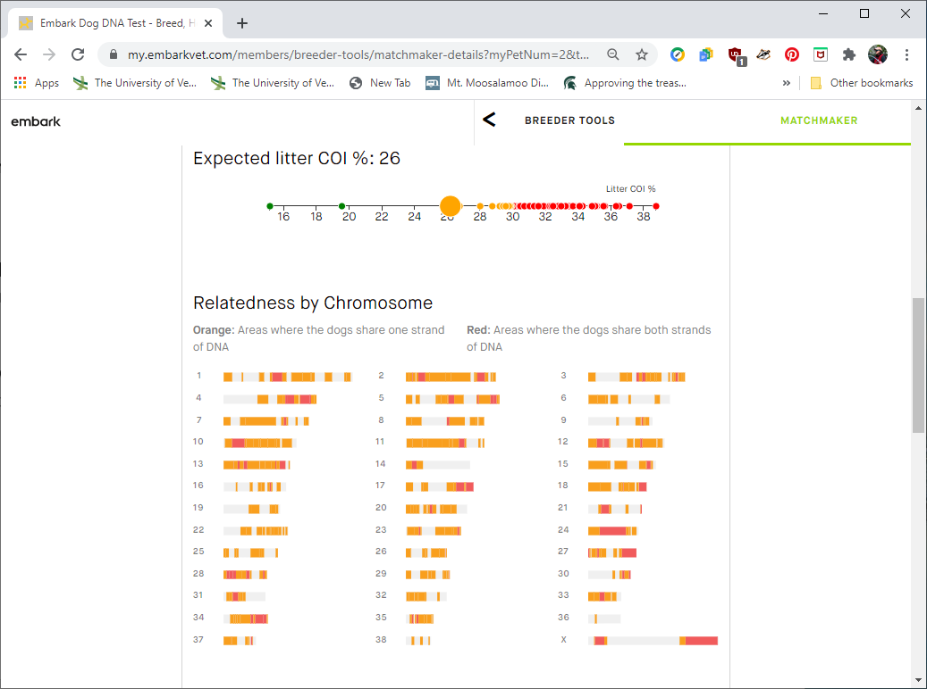
Looking a little deeper…
In the “RELATEDNESS BY CHROMOSOME” section, you will see ORANGE, RED, and White areas on each chromosome.
LESS COLOR IS BETTER
White areas are where the dogs do not share strands of DNA on a particular chromosome.
Orange areas show where the two dogs share one strand of DNA on that chromosome.
Red areas show that the two dogs share both strands of DNA; this means there can be no variation passed on to the offspring.

Slide 9
Check out the traits….
Will this pair produce tri-color Stabijs? (not currently accepted in the breed standard)
Can these two dogs produce brown Stabyhouns?
Dominant Black (K Locus)
The Dominant Black gene (K Locus) affects pigment switching between eumelanin (black) and phaeomelanin (red or yellow) by interacting with the Agouti and MC1R genes.
A Locus (ASIP)
The A Locus controls switching between black and red pigment in hair cells, but it will only be expressed in dogs that are k^{y}k^{y} at the K Locus. Agouti (also called “Wolf Sable”) dogs have red hairs with black tips, mostly on their head and back. Black and tan dogs are mostly black or brown with lighter patches on their cheeks, eyebrows, chest, and legs. Recessive black dogs (aa) will express as if KBKB in the K locus.
Brown (B Locus/Chocolate/Liver)
The Brown gene dilutes eumelanin (black pigment) to brown but does not affect phaeomelanin (red/yellow pigment).

